Slide 1

Comfy Week !
Présente

Slide 2

“A comfortable week with ComfyUI.”
“Une semaine confortable avec ComfyUI.”

Slide 3





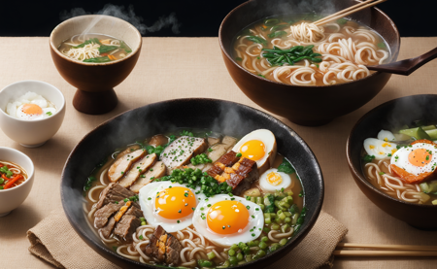

Slide 4







Slide 5

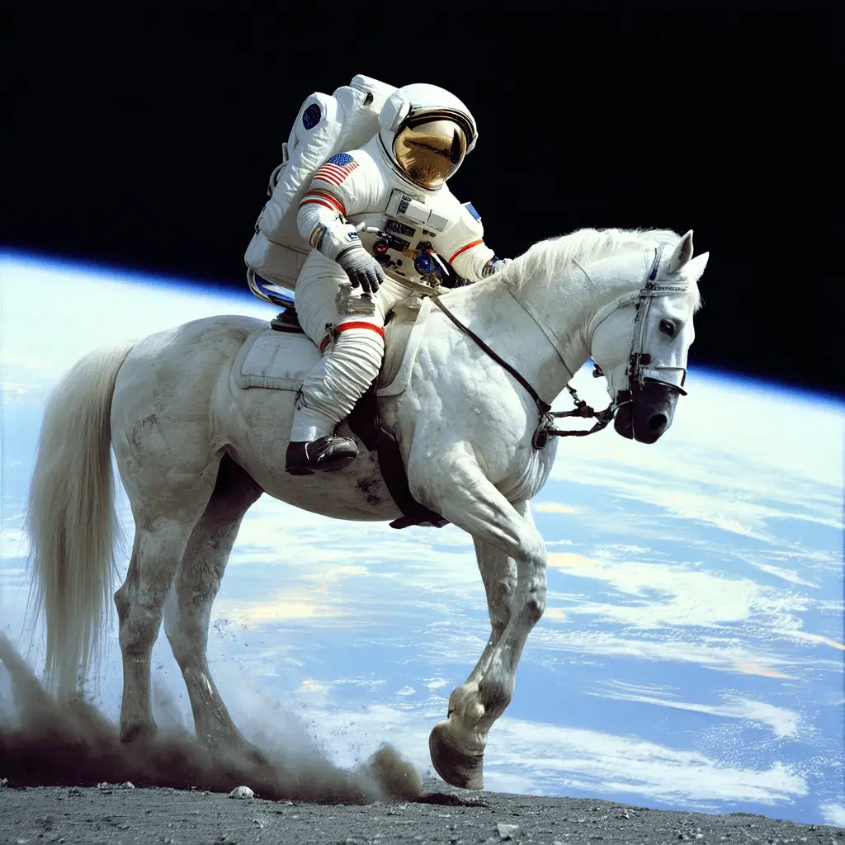



What is stable diffusion?
Stable Diffusion is a text-to-image deep learning model
Code and model weights have been released publicly
Can run on a GPU with 4 GB VRAM (<500$ hardware)
An astronaut
riding a horse

Slide 6
Stable diffusion-based projects
Fine-tuning (e.g.: Dream Shaper, Epic Realism, Realistic Vision, …)
Control Nets (with open pose, canny, depth maps, …)
IP Adapter (Image Prompt Adapter)
LoRA modifiers (Low-Rank Adaptation)
Face ID
PulID
ComfyUI

Slide 7
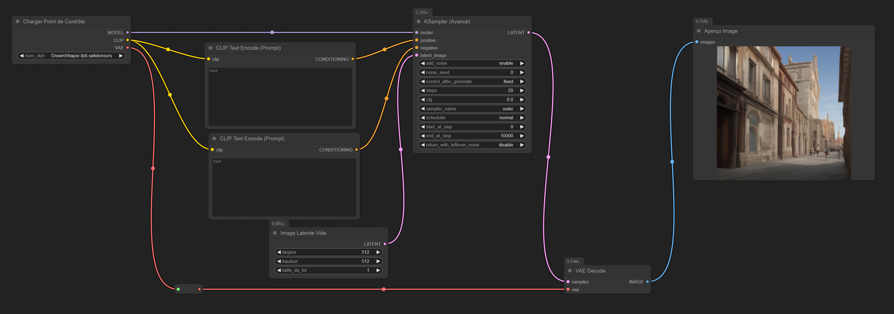
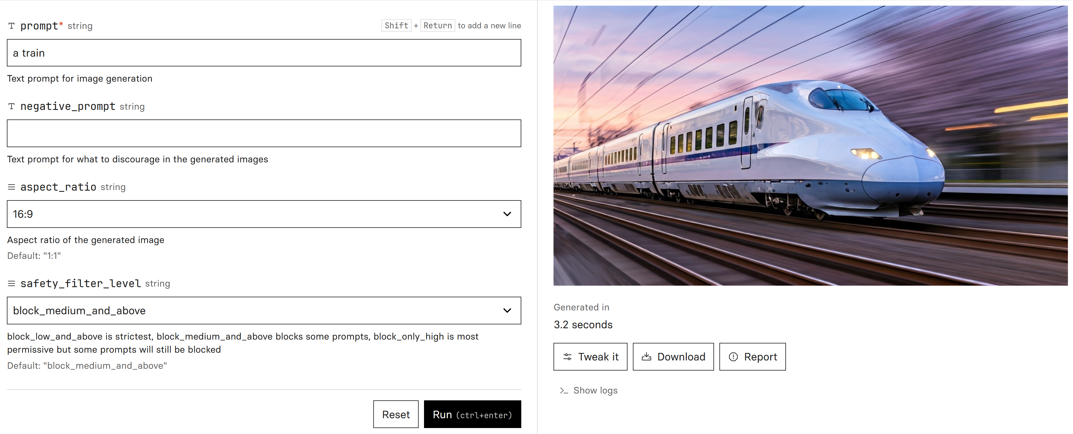
What is ComfyUI?
ComfyUI
Others (Automatic1111, etc...)
Hard-but-powerful nodal interface
Easy-to-use “click-buttons” web interface

Slide 8
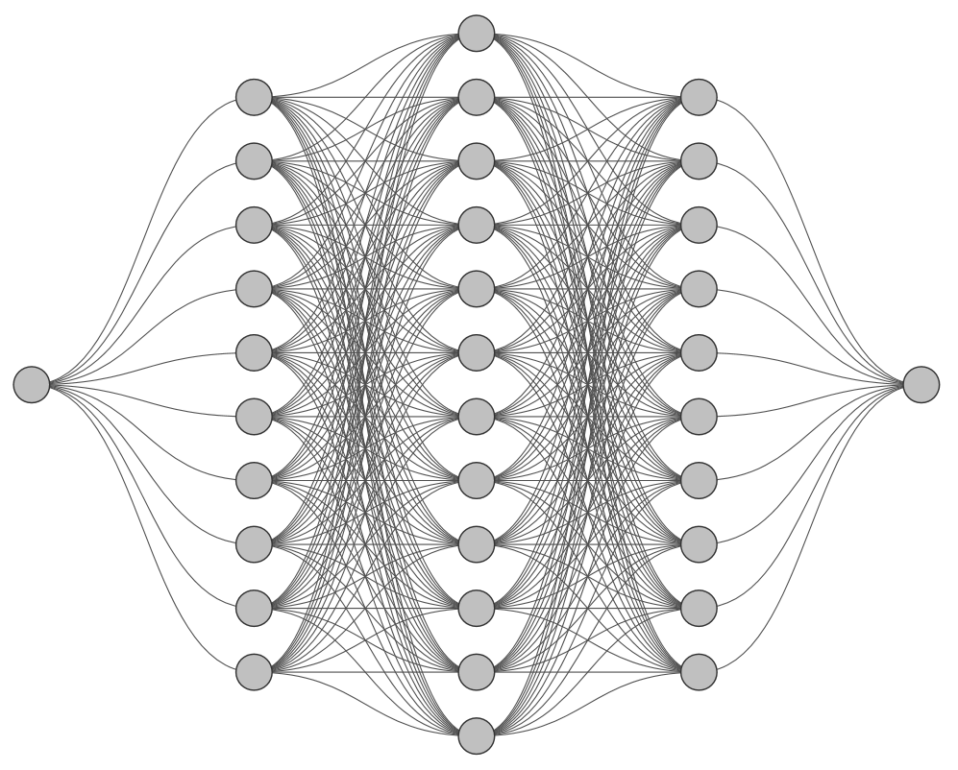

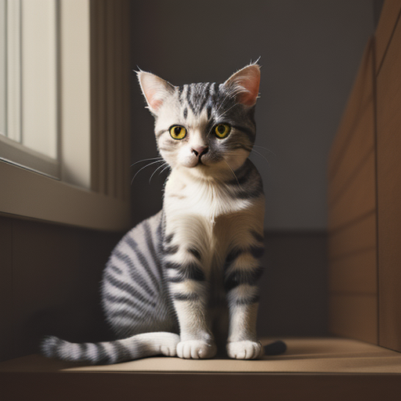

What is a deep learning model?
“Un chat”

Slide 9
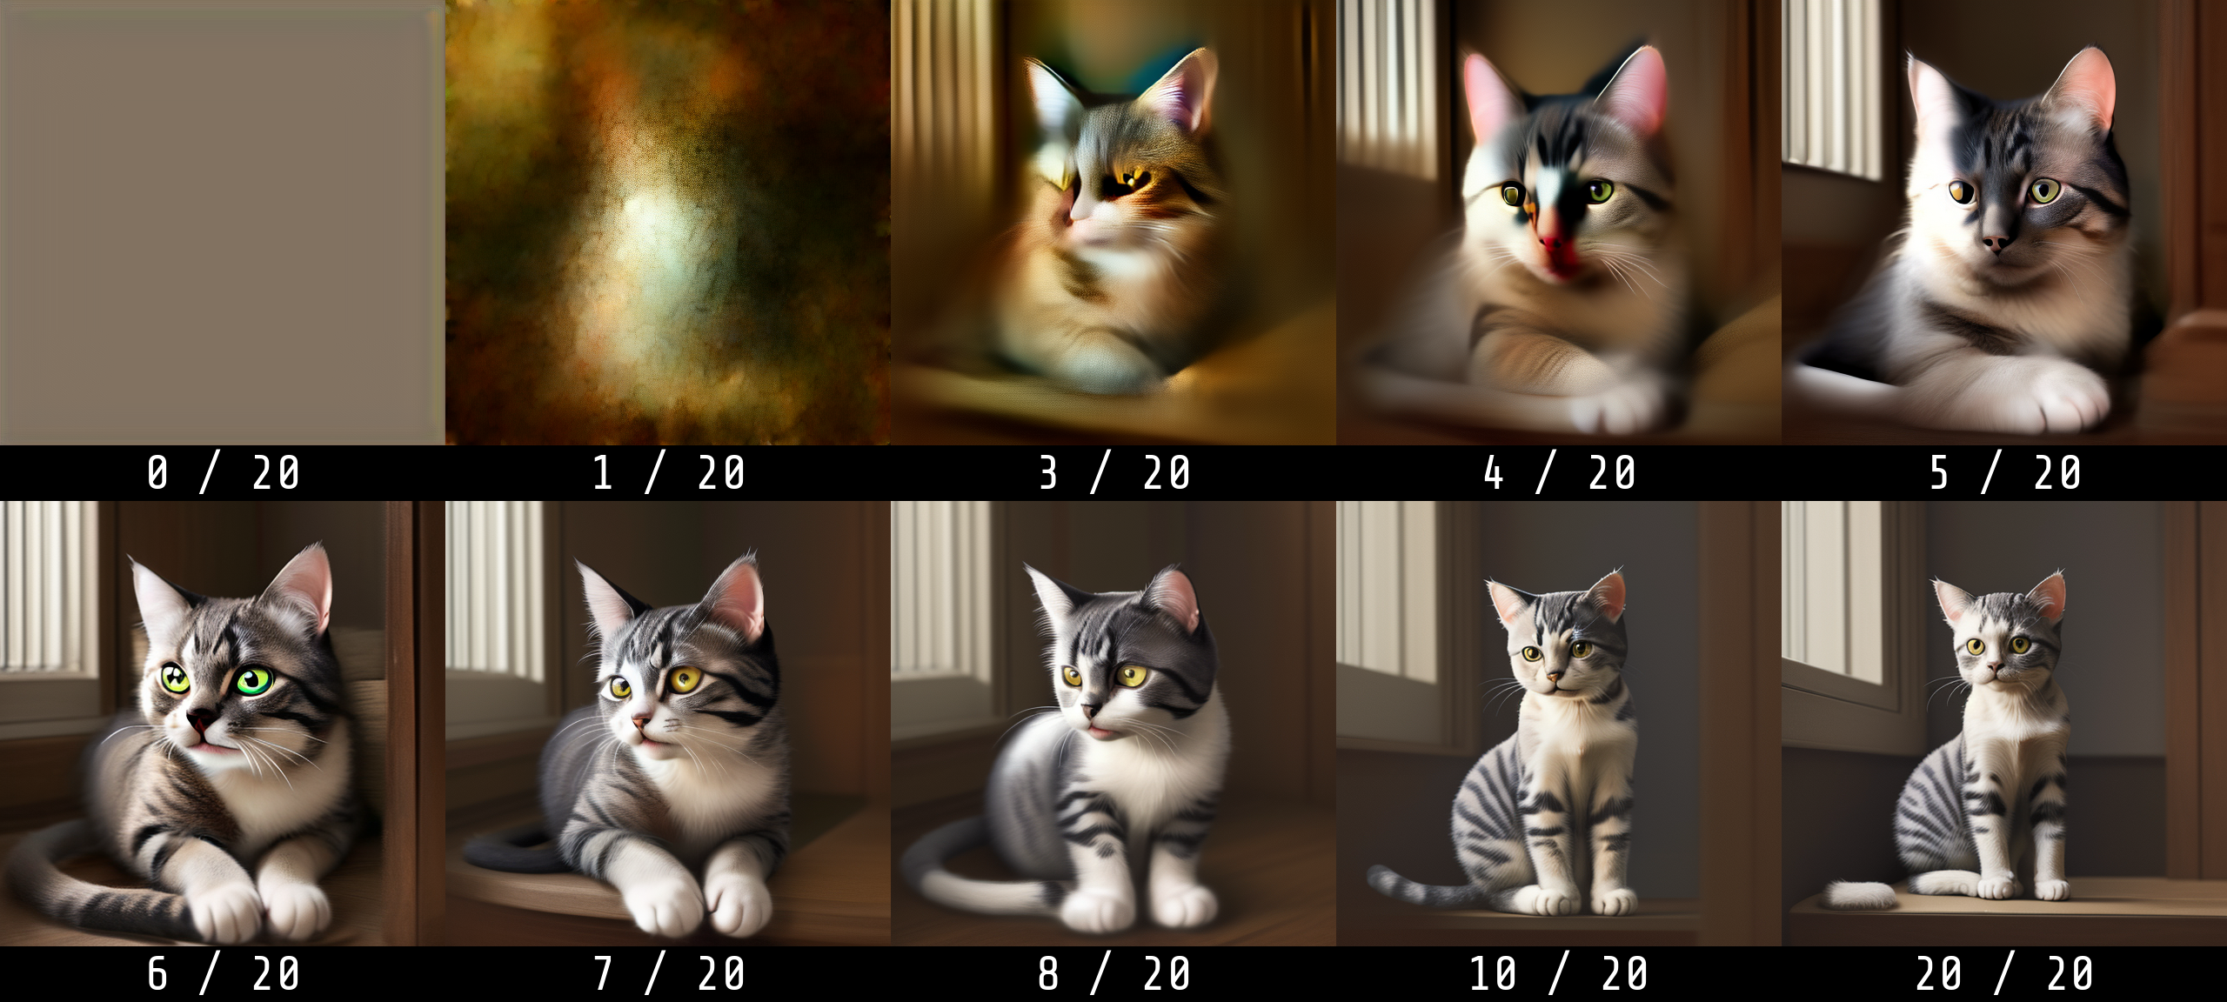
Generation step by step
Prompt: “a cat”

Slide 10

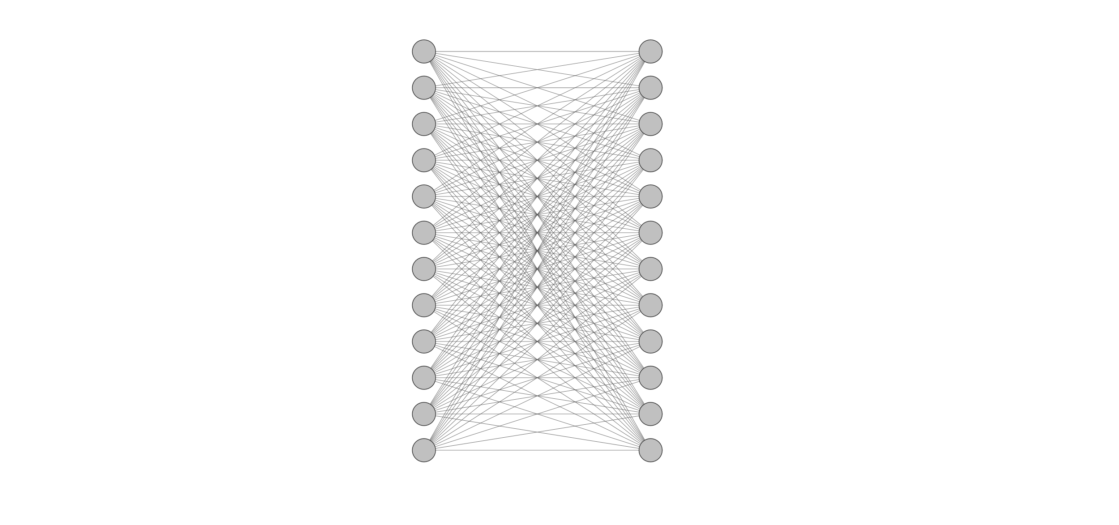
What is a machine learning / artificial intelligence model?
Small network
Big network
+ Low compute cost
- Low “intelligence”
+ High “intelligence”
- High compute cost

Slide 11


Random images vs Meaningful images

Slide 12
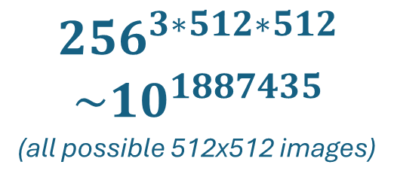
Space of images
$${256}^{3∗512∗512}$$
$$\sim 10^{1887435}$$
(all possible 512x512 images)
“Meaningful” images

Slide 13
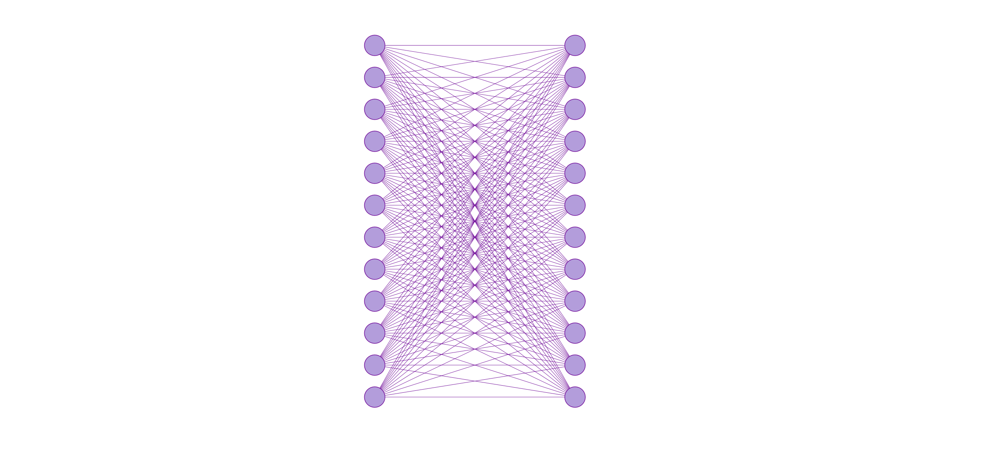

Variational Auto Encoder
VAE
Input image
Output image
Input image
Output image
(encode)
(decode)
Image-space network
Latent-space network

Slide 14
Variational Auto Encoder
(multi-steps)
VAE
Input image
Output image
Input image
(encode)
(decode)
Output image
Image-space network
Latent-space network

Slide 15
Noise prediction
Noise Prediction
Input latent
Output latent
Noise
-
Denoised latent image
Input latent
Output latent
Noisy latent image

Slide 16
Denoising sampler
Latent
Empty
Noise
Step 1
Latent
Step 1
Noise
Step 1
Latent
Step 1
Noise
Step 1
Latent
Step 1
Noise
Step 1
Latent
Step 1
Neuron
value

Slide 17



Sampler
Prompt: “a cat”
Euler
DPM++2M
LCM

Slide 18
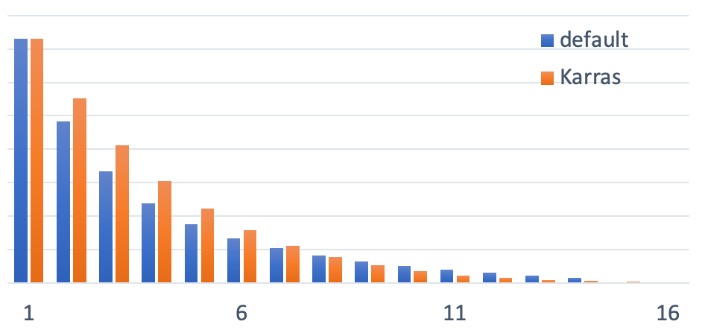
Noise Schedule

Slide 19




Noise scheduler
Prompt: “a cat”
Normal
Karras
Exponential
SGM
Uniform

Slide 20
Noise scheduler
Prompt: “a cat”
Normal
Karras
Exponential

Slide 21
Prompting the model
Denoised (no prompt)
Input latent
Output latent
-
Denoised (re-enforced prompted)
Input latent
Output latent
Latent
Denoised (prompted)
Prompt

Slide 22
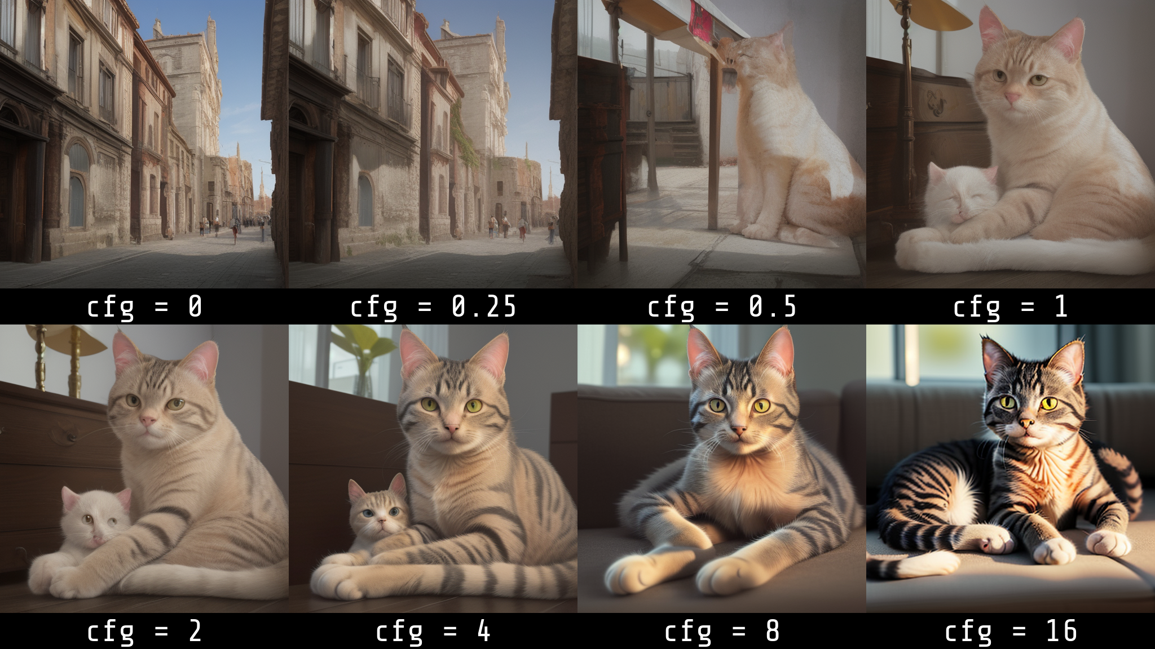
Prompting effect (“cfg”)
Prompt: “a cat”

Slide 23
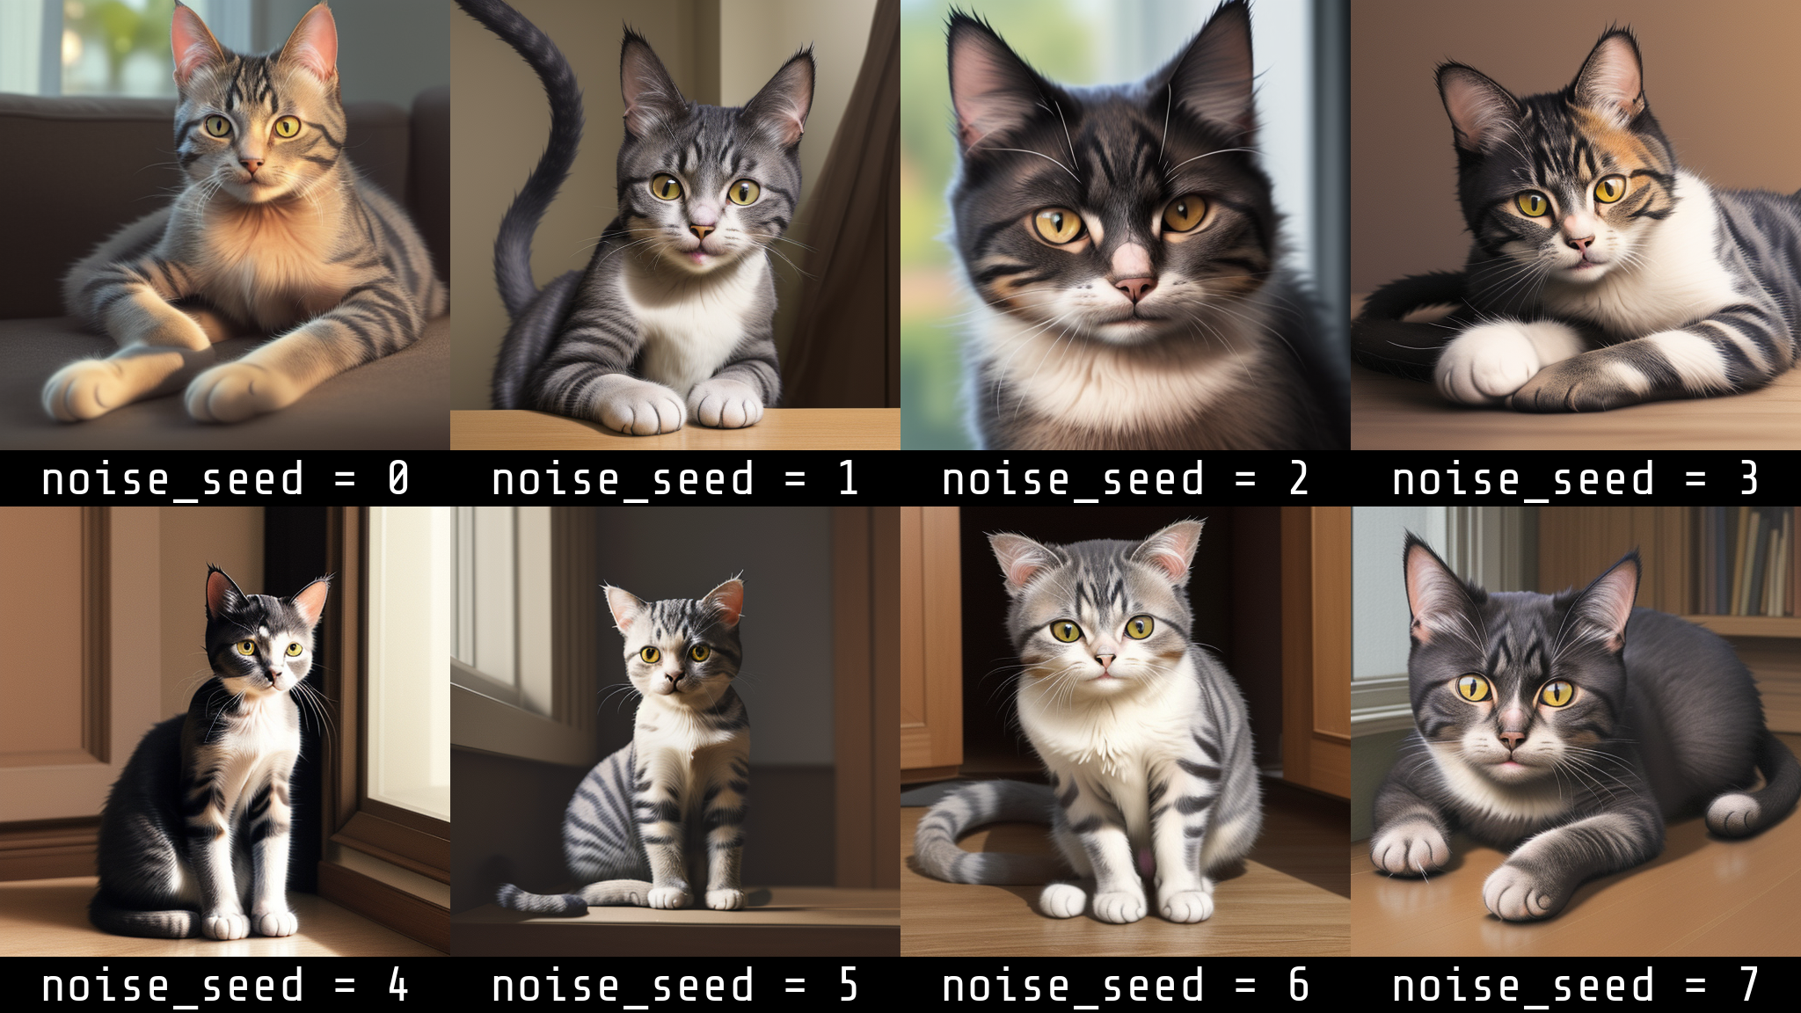
Noise seed
Prompt: “a cat”

Slide 24
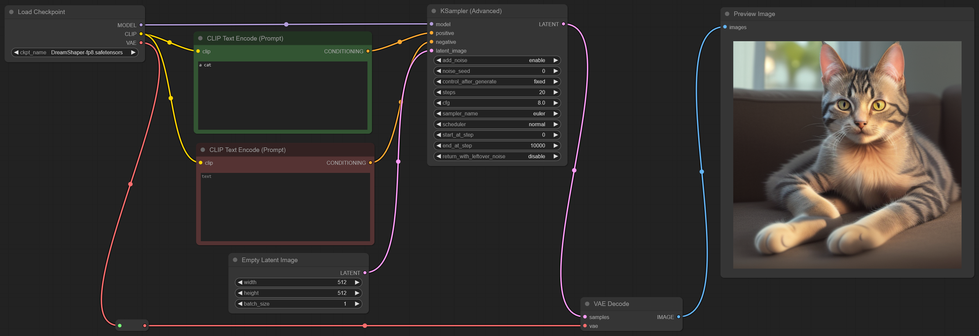
Basic ComfyUI Workflow

